Slide 1
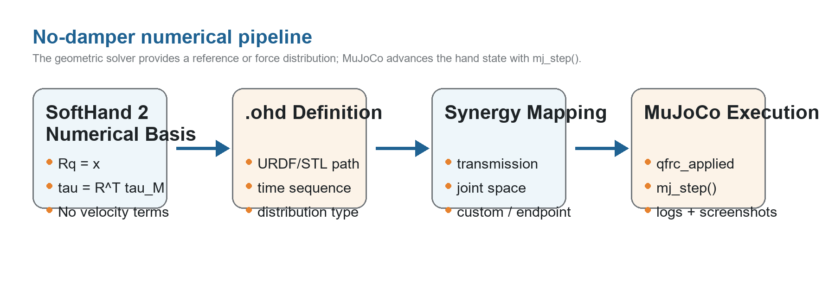
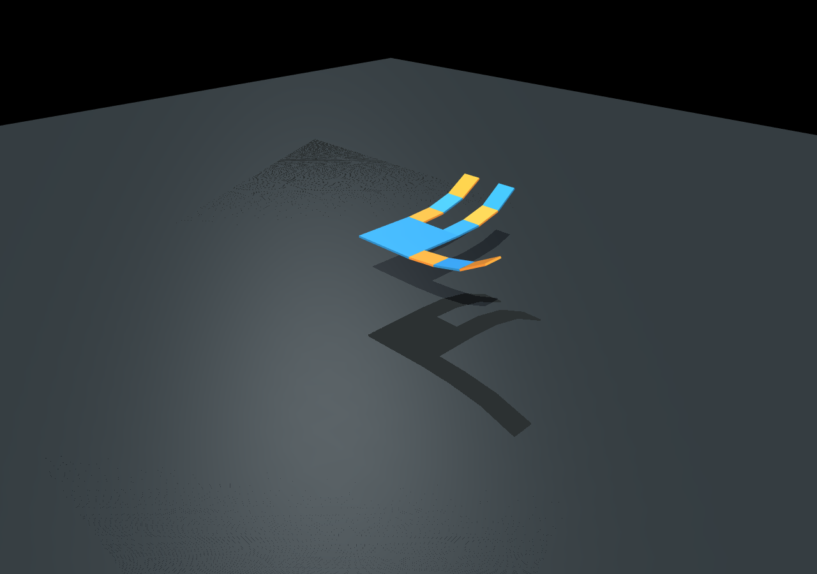
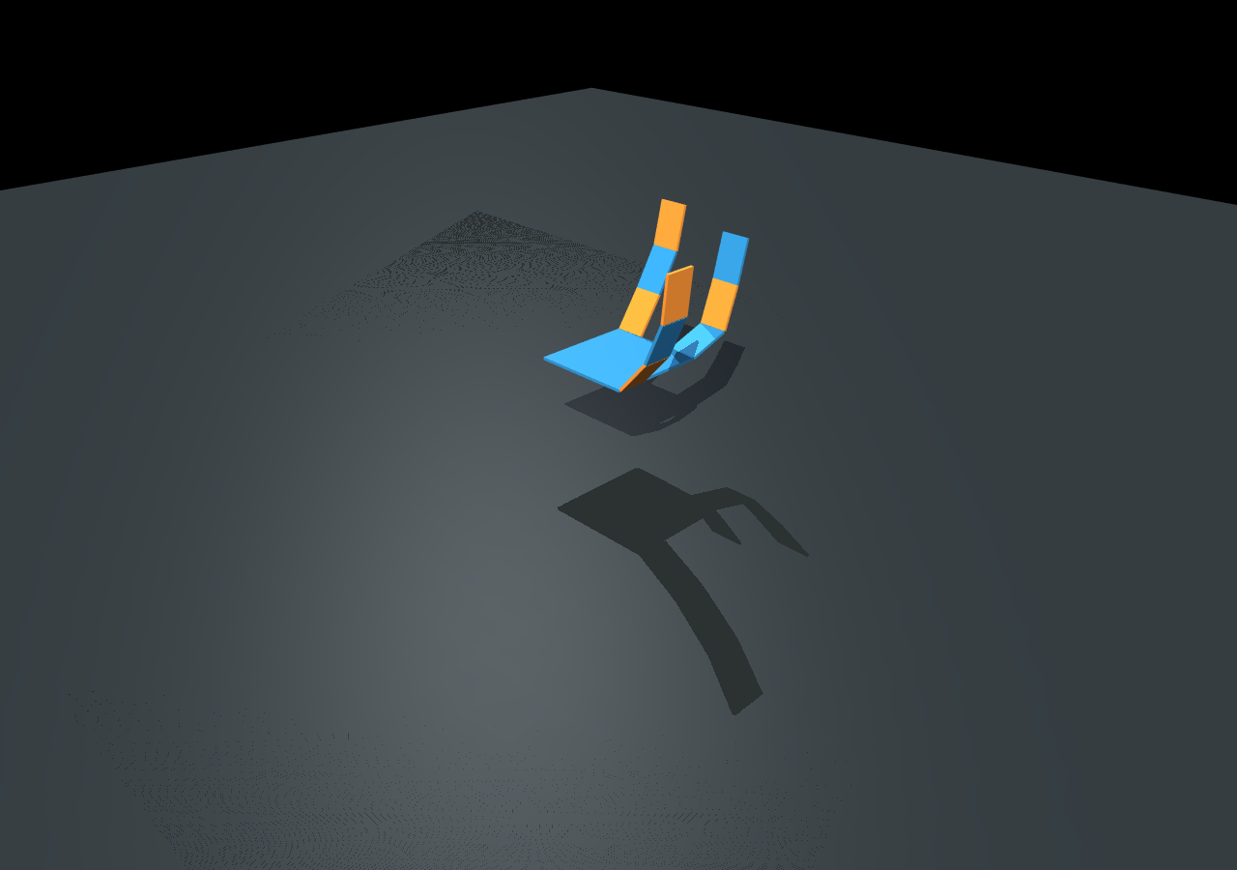
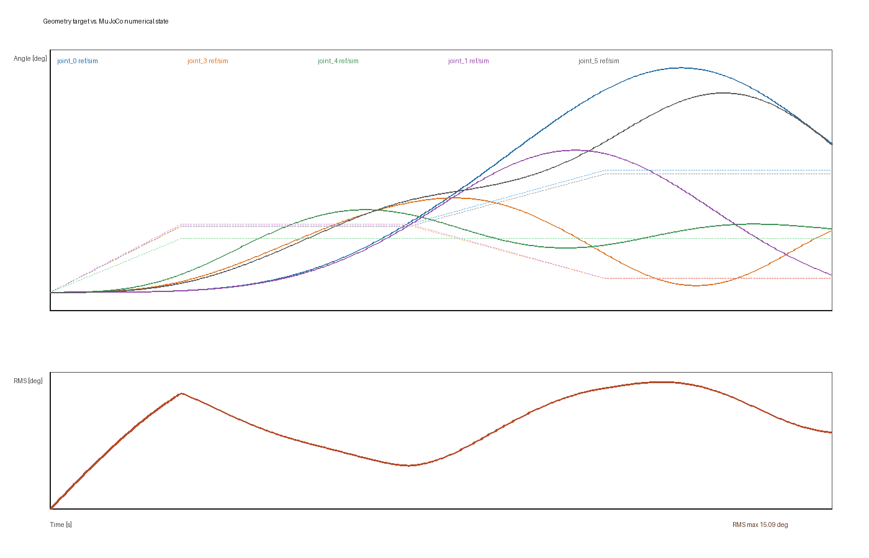
Upgraded Numerical Simulation Framework
Yushuo Wang | Department of Mechanical Engineering, Tsinghua University
Problem Statement
Methodology
Geometric playback can show the free-space synergy posture, but it cannot answer how a hand evolves under inertia, force input, constraints, and numerical integration. The project therefore upgrades the origami-hand simulator from direct qpos assignment to a MuJoCo mj_step pipeline driven by .ohd simulation definitions.
Input
.ohd hand model
time-varying drivers
distribution type
Core Solver
q_ref or tau map
qfrc_applied
mj_step()
Output
joint logs
rendered snapshots
geometry-vs-MuJoCo error
Design constraints: no damper elements, no viscous or velocity-proportional damping, and no non-MuJoCo physics engine. Joint armature is allowed only as inertia scaling for numerical stability.
Implementation steps:
1. Parse .ohd simulation block: model path, duration, dt, drivers, distribution, outputs.
2. Convert URDF to a no-damping MJCF model and map URDF joints back to synergy indices.
3. Interpolate driver inputs and compute q_ref or direct generalized force.
4. Apply joint torques through qfrc_applied and advance MuJoCo with mj_step().
Experimental Results
Literature Review
t = 0.350 s: common-mode closing stage
t = 1.050 s: differential input added
SoftHand and SoftHand 2 model low-dimensional hand actuation through tendon transmission matrices. The useful no-damper subset is:
q = S sigma
R q = x
tau = R^T tau_M
q = E^{-1} R^T (R E^{-1} R^T)^{-1} x
q = (S_A + S_B) sigma_c + (S_A - S_B) sigma_d
The implementation keeps the mapping idea but removes velocity-dependent sliding, viscous friction, and dynamic damper terms. Tendon routing in the .ohd file is converted into R_A and R_B, then into common and differential synergy directions. This preserves the mechanical-intelligence interpretation while giving MuJoCo responsibility for state integration.
600 steps
dt = 0.002 s
9 joints / 2 drivers
No damping
No damper XML
No velocity actuator
Verified distributions
SDAS/transmission
joint/custom/endpoint
Reusable code: OrigamiHandDesign, URDF/STL export, transmission_builder, and the Schur-complement synergy solver. Replaced code: the old geometry viewer that wrote qpos directly, and the older custom ODE path containing damping-related terms.
Conclusion
The upgraded framework now supports .ohd-driven MuJoCo numerical simulation without damper or velocity-damping terms. Compared with the previous geometric viewer, the new path produces time histories, numerical states, rendered snapshots, and an explicit geometry-vs-MuJoCo comparison. The interface is extensible: users can switch the distribution matrix without changing the hand model.
Next work: add calibrated contact objects, refine tendon-force input scaling, and use task-specific synergy extraction to generate task-specific routing plates.

